Slide 1

Net-Centric Computing Division Computer Science Department
Bogor Agricultural University
KOM 312
KOMUNIKASI DATA
DAN JARINGAN KOMPUTER
Transmission Systems and the Telephone Network
Contain slides by Leon-Garcia and Widjaja
Sri Wahjuni
my_juni04[at]apps.ipb.ac.id

Slide 2
DIGITAL COMMUNICATION SYSTEM
Digital info.
Textual
info.
Format
source
Pulse
modulate
Transmit
Analog
info.
Sample
Quantize
Encode
Pulse
waveforms
Channel
Bit stream
swj/21
Format
Analog
info.
Low-pass
filter
Decode
Demodulate/
Detect
Receive
sink
Textual
info.
Digital info.

Slide 3
AGENDA
Multiplexing
  Frequency-Division Multiplexing (FDM)
  Wavelength Division Multiplexing (WDM)
  Time-Division Multiplexing (TDM)
Circuit Switches
  The Telephone Network
  Signaling
From 1G to 5G
swj/21

Slide 4
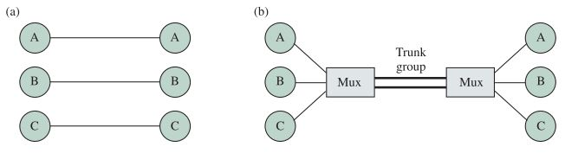
MULTIPLEXING
swj/21
Teknik yang memungkinkan transmisi beberapa sinyal secara simultan melalui jalur data tunggal
Berbagi sumber daya jaringan
Sumber daya: waktu, bandwidth
Multiplexing dapat meningkatkan efisiensi bandwidth

Slide 5
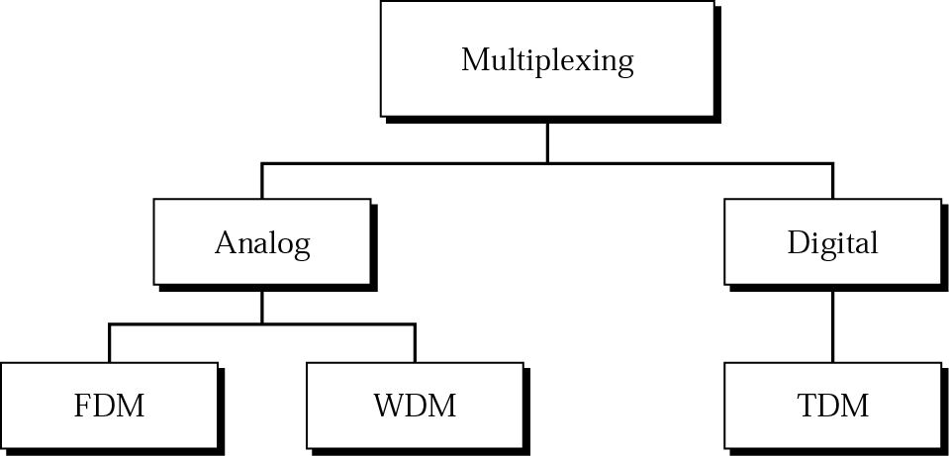
CATEGORIES OF MULTIPLEXING
swj/21

Slide 6
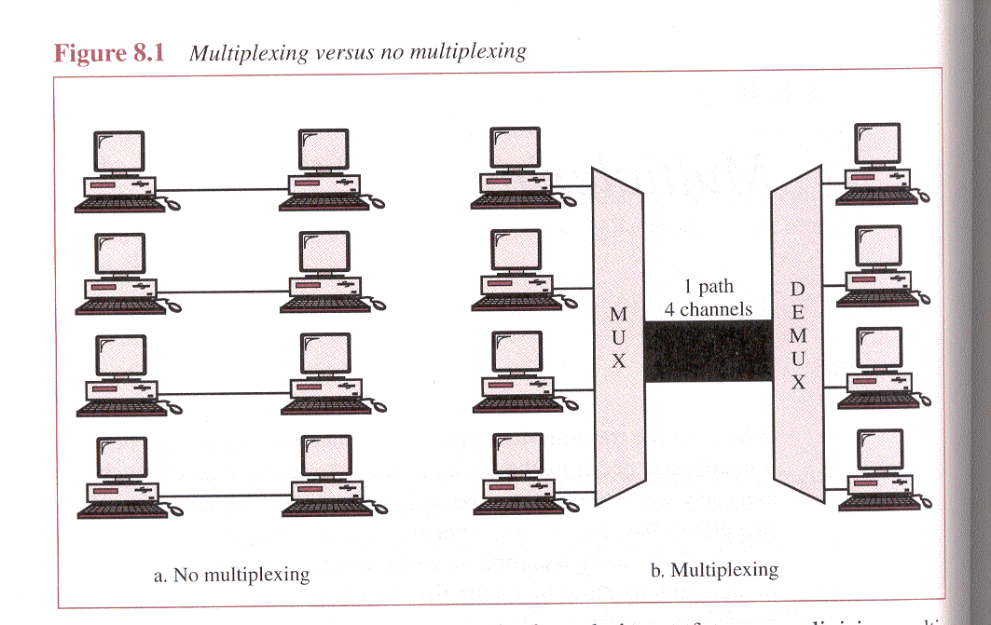
FREQUENCY DIVISION MULTIPLEXING (FDM)
Bandwidth yang tersedia pada media komunikasi (link) lebih besar dari bandwidth yang diperlukan oleh sebuah channel
Setiap sinyal dimodulasikan ke frekuensi pembawa (carrier signal) yang berbeda-beda
swj/21
Frekuensi pembawa dipisahkan oleh guard bands untuk menghindari overlap
Contoh: broadcast radio, cable TV, celullar telephony (GSM)
Layer datalink → FDMA

Slide 7
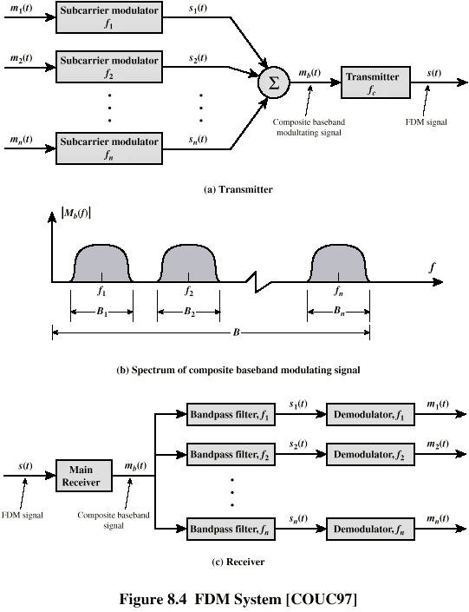
FDM SYSTEM
swj/21

Slide 8
TELCO BUILDING BLOCKS
multiplexing 12 kanal suara, 4kHz tiap kanal (60-108 kHz) → grup
Multiplexing lima grups (60 sinyal suara), 48kHz tiap grup (312-552kHz) → supergrup
Multiplexing 10 supergrup (600 sinyal suara, 564-3084 kHz) → mastergrup
swj/21

Slide 9
CONTOH 1
Assume that a voice channel occupies a bandwidth of 4 kHz. We need to combine three voice channels into a link with a bandwidth of 12 kHz, from 20 to 32 kHz. Show the configuration using the frequency domain without the use of guard bands.
swj/21
Solution
Shift (modulate) each of the three voice channels to a different bandwidth.

Slide 10
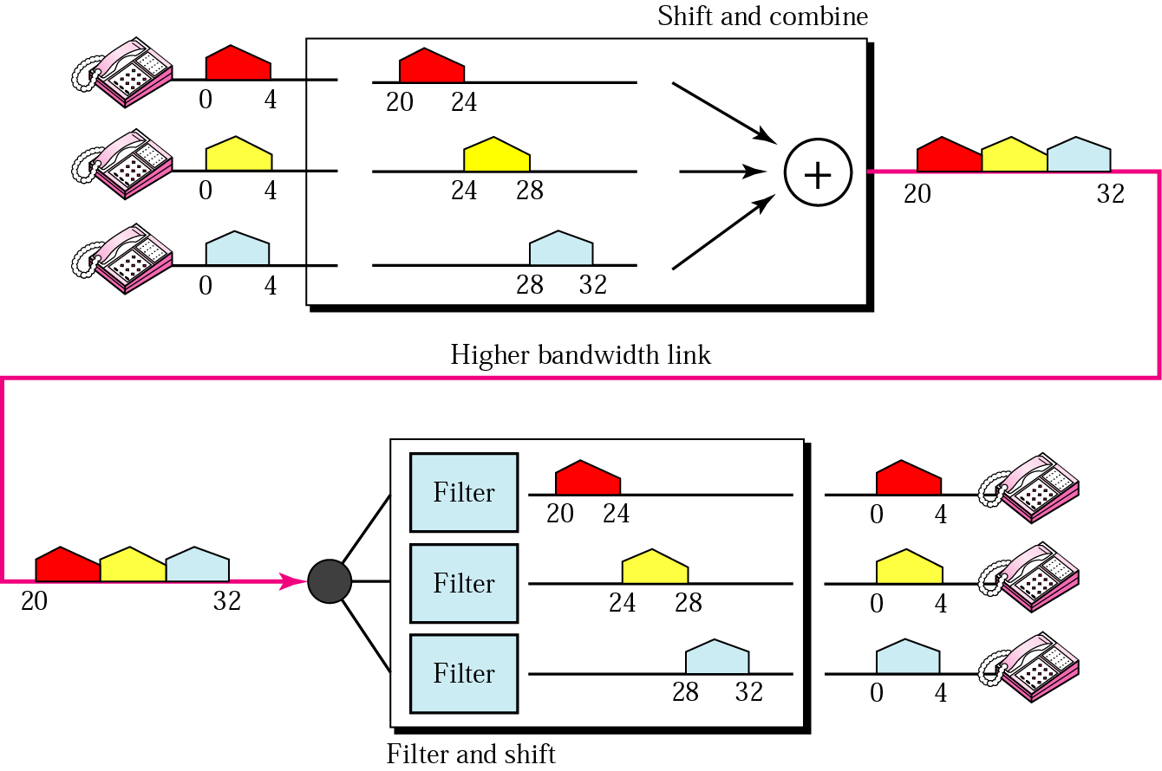
SOLUSI UNTUK CONTOH 1
swj/21

Slide 11
CONTOH 2
Five channels, each with a 100-KHz bandwidth, are to be multiplexed together. What is the minimum bandwidth of the link if there is a need for a guard band of 10 KHz between the channels to prevent interference?
swj/21
Solution
For five channels, we need at least four guard bands. This means that the required bandwidth is at least
5 x 100 + 4 x 10 = 540 KHz

Slide 12
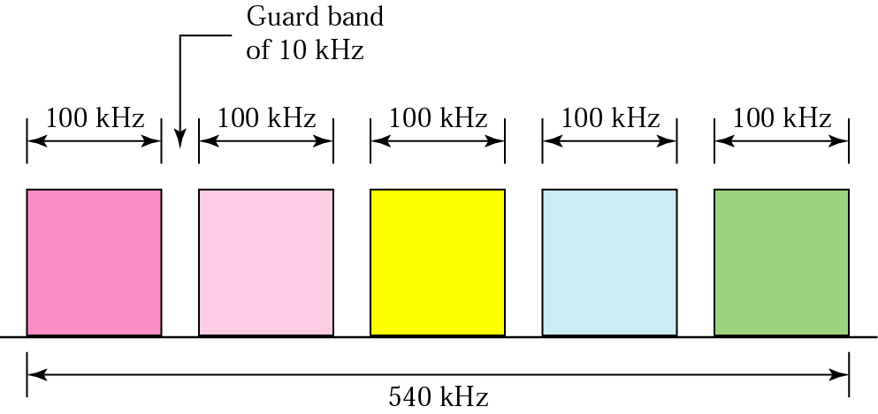
SOLUSI UNTUK CONTOH 2
swj/21

Slide 13
AGENDA
Multiplexing
  Frequency Division Multiplexing
  Wavelength Division Multiplexing (WDM)
  Time Division Multiplexing
Circuit Switches
  The Telephone Network
  Signaling
From 1G to 5G
swj/21

Slide 14
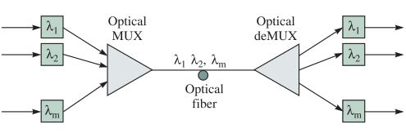
WAVELENGTH DIVISION MULTIPLEXING (WDM)
Versi optik dari FDM
Beberapa panjang gelombang atau warna laser bekerja secara simultan dalam sebuah serat optik
Konsentrasi data sangat tinggi
  Contoh: 16 channel OC-48 = 16*2.5Gbps = 40Gbps
swj/21

Slide 15
WAVELENGTH DIVISION MULTIPLEXING
Beberapa berkas cahaya (beam) pada frekuensi yang berbeda
Setiap warna cahaya (wavelength) mewakili channel berbeda
1997 Bell Labs
  100 beams
  10 Gbps setiap beam →1 Tbps
Sistem komersial saat ini: 160 channels @10 Gbps
Lab systems (Alcatel) 256 channels @ 39.8 Gbps
  10.1 Tbps
  Jarak tempuh lebih dari 100km
swj/21

Slide 16
AGENDA
Multiplexing
  Frequency Division Multiplexing
  Wavelength Division Multiplexing (WDM)
  Time Division Multiplexing
    Synchronous TDM
      ISDN
      SONET
    Statistical Multiplexing
Circuit Switches
  The Telephone Network
  Signaling
From 1G to 5G
swj/21

Slide 17
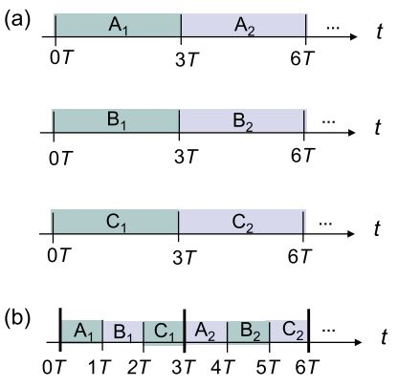
TIME-DIVISION MULTIPLEXING (TDM)
Data rate dari media komunikasi (link) melebihi data rate yang dibutuhkan perangkat pengirim/ penerima
Pada source ditetapkan time slot tertentu (tidak harus terdistribusi merata)
Time slot dikelompokkan ke dalam frame.
Time slot tetap dialokasikan meskipun tidak ada data
Layer datalink → TDMA
swj/21

Slide 18
FRAMING
Tidak ada karakter SYNC antar frame TDM
  Mekanisme sinkronisasi harus ditambahkan
Penambahan digit framing
  Pada setiap frame TDM ditambahkan satu bit control
  Pada control channel digunakan pola bit yang sudah dikenali
swj/21

Slide 19
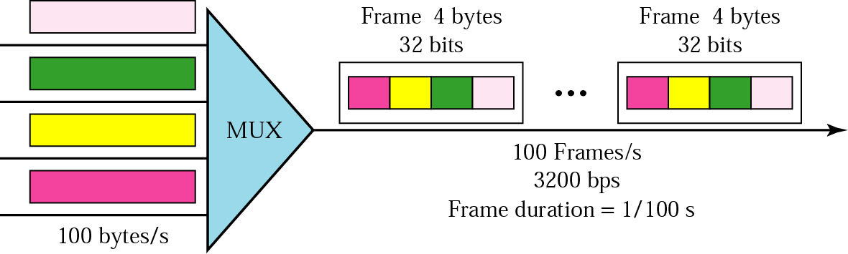
CONTOH-1
Four channels are multiplexed using TDM. If each channel sends 100 bytes/s and we multiplex 1 byte per channel, show the frame traveling on the link, the size of the frame, the frame rate, the duration of a frame, and the bit rate for the link.
swj/21

Slide 20
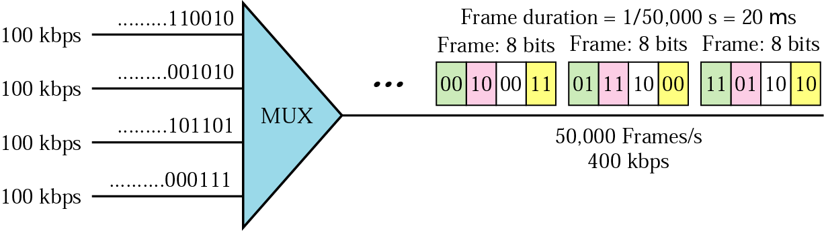
CONTOH-2
A multiplexer combines four 100-Kbps channels using a time slot of 2 bits. Show the output with four arbitrary inputs. What is the frame rate? What is the frame duration? What is the bit rate? What is the bit duration?
swj/21

Slide 21
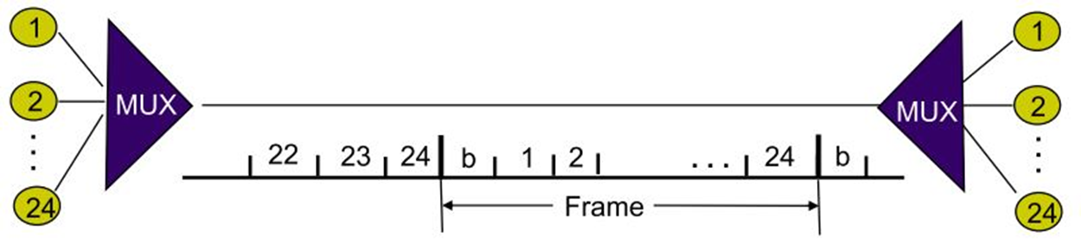
FRAMING BIT
Sistem telepon T-1 membawa 24 sambungan telepon digital (setiap percakapan telepon digital 8000 samples/s, dinyatakan dengan 8 bit per sample).
Sistem telepon T-1 menggunakan aturan transmisi frame: 24 slots dengan 8 bit per slot. 1 slot membawa 1 sampel PCM untuk satu sambungan. Awal setiap frame diindikasikan dengan sebuah bit. Kecepatan transmisi yang dihasilkan adalah:
swj/21
(1+24*8)bit/frame* 8000 frame/second = 1.544Mbps
DS-1

Slide 22
AGENDA
Multiplexing
  Frequency Division Multiplexing
  Time Division Multiplexing
    Synchronous TDM
    Statistical Multiplexing
Circuit Switches
  The Telephone Network
  Signaling
From 1G to 5G
swj/21

Slide 23
STATISTICAL TDM
Synchronous TDM: terjadi pemborosan slots
Statistical TDM: alokasi time slots dinamis berdasarkan permintaan
Multiplexer memantau jalur input dan mengumpulkan data sampai frame penuh
Memungkinkan data rate pada link lebih rendah daripada agregat rate pada jalur input
Selengkapnya pada pertemuan-6
swj/21

Slide 24
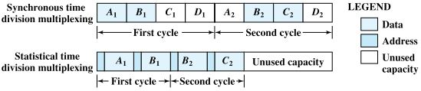
SYNCHRONOUS VS STATISTICAL TDM
swj/21

Slide 25
AGENDA
Multiplexing
Circuit Switches
  The Telephone Network
  Signaling
From 1G to 5G
swj/21

Slide 26
COMMUNICATION NETWORKS
Switched networks
End nodes send to one (or more) end nodes
Broadcast networks
End nodes share a common channel (TV, radio…)
Circuit switching
Dedicated circuit per call
(telephone, ISDN
ISDN: Integrated Service
Digital Network)
Packet switching
Data sent in discrete portions
(the Internet)
swj/21
Datagram networks
Each packet switched
independently
Virtual circuit networks
Pre-established path

Slide 27
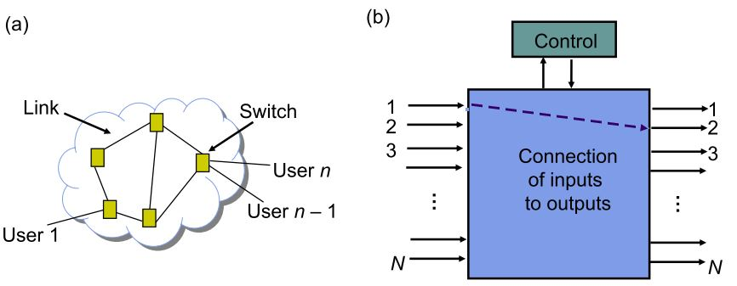
CIRCUIT SWITCH NETWORK
Circuit switching: dua node (2 perangkat, misal telepon-komputer) membentuk kanal komunikasi tertentu sebelum komunikasi dimulai.
Jenis :
  Space-Division Switches
  Time-Division Switches
swj/21

Slide 28
Datagram packet switching
Packet 1
Packet 1
Packet 2
swj/21
Packet 2
Packet 2
Figure 7.15

Slide 29
BACK
Virtual-circuit switching
Packet
Packet
swj/21
Question: why called virtual-circuit?
Because resources, e.g., switches, buffers and lines, are shared
by packets from multiple connections, not dedicated to one
specific connection.
Figure 7.17

Slide 30
AGENDA
Multiplexing
Circuit Switches
  The Telephone Network
  Signaling
From 1G to 5G
swj/21

Slide 31
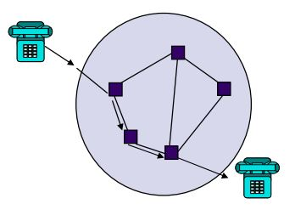
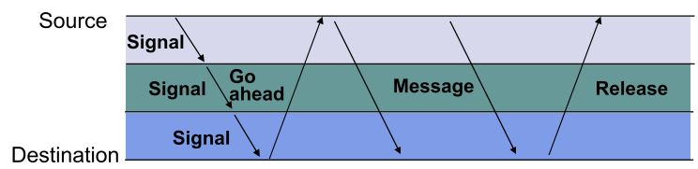
THE TELEPHONE NETWORK
Circuit Switching:
Awal : memungkinkan arus mengalir dari caller ke receiver pada jalur yang disiapkan
Saat ini: dikombinasikan dengan transmisi digital dan switching
swj/21
Call Setup : 3 fase connection oriented communication (setup, transfer, teardown)

Slide 32
AGENDA
Multiplexing
Circuit Switches
  The Telephone Network
  Signaling
From 1G to 5G
swj/21

Slide 33
SIGNALING
Pesan pensinyalan (signalling) harus dipertukarkan untuk membangun sebuah panggilan telepon
Dua pesan signaling dasar:
  Antara user dan jaringan
  Di dalam jaringan
swj/21

Slide 34
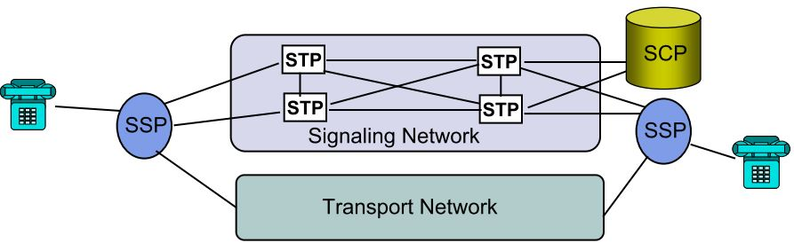

SIGNALING NETWORK
swj/21
Signaling network:
  Membawa informasi untuk mengontrol koneksi
  Menyediakan komunikasi antar komputer yang mengotrol switch
Transport network: membawa informasi user

Slide 35
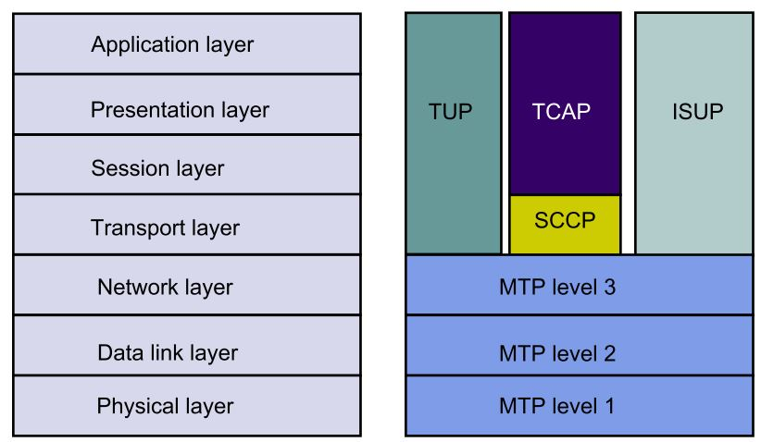

SIGNALING SYSTEM 7 (SS7) ARCHITECTURE
SS7 : jaringan paket yang mengontrol panggilan telepon (setting up, managing, dan releasing)
SS7 : diterapkan pada PSTN, jaringan cellular (GSM), dan Intelligent Network
swj/21
MTP level 1:
  E-1 (2.048 Mbps = 32 channel @ 64 kbps)
  T-1 (1.544 Mbps = 24 channel @ 64 kbps)
  V-35 (64 kbps)
  DS-0 (64 kbps)
  DS-0A(56 kbps)
  MTP level 2: OSI data link layer

Slide 36
SIGNALING SYSTEM 7 (SS7) ARCHITECTURE
MTP level 3:
  Mengimplementasikan SS7
  Menyediakan routing dan congestion control
ISUP (untuk ISDN, TUP untuk negara lain):
  Melakukan basic setup, management, dan release pada pangilan telepon
SCCP:
  Menerjemahkan “global titles” ke dalam application identifier (ID) pada titik pensinyalan tujuan
  Semacam DNS di Internet
TCAP:
  Menentukan messages dan protokol yang digunakan untuk berkomunikasi antar applikasi yang mengunakan jaringan SS7
swj/21

Slide 37
AGENDA
Multiplexing
Circuit Switches
From 1G to 5G
swj/21

Slide 38
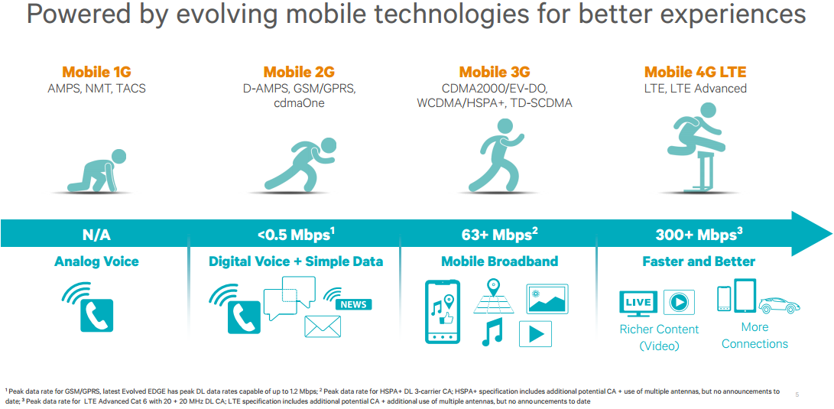
1G TO 4G
swj/21

Slide 39
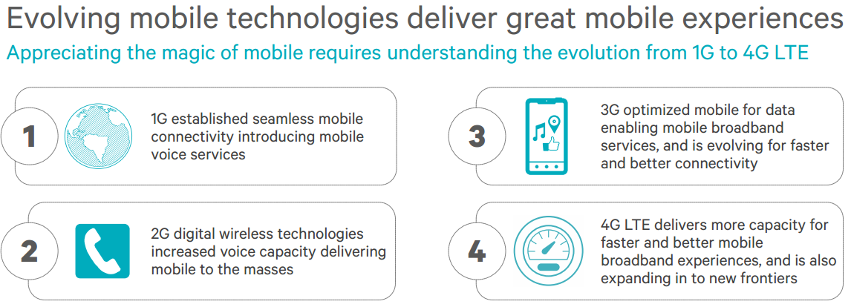
swj/21

Slide 40
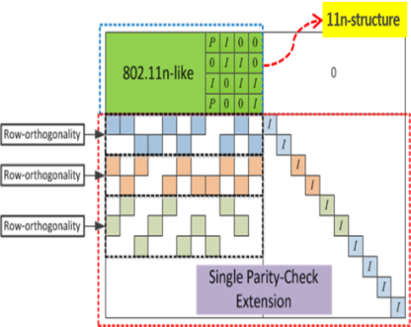
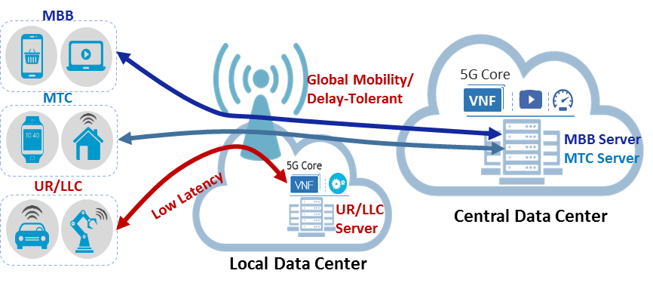

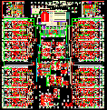

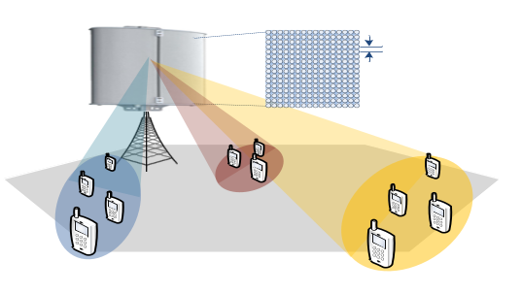

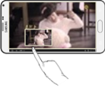






5G Service Enablers – meeting requirements
mmWave System/RFIC/Ant.
New Channel Coding
Network Slicing
700 MHz
3 GHz
18
27
30 GHz
Legacy Bands
New Bands
mmWave
RFIC
Wide
Coverage
Antenna
LDPC (Low-Density Parity-Check )
< 6 GHz Massive MIMO
Massive Connectivity (IoT)
Low Latency NW
Half
-Wavelength
Grant-based
Multiple Access
Grant-Free
Multiple Access
① Radio
Information
② TCP Rate
Control
eNB
3~4 Step
1 Step
eNB
UE
UE
Data
Mobile
BS
Server

Slide 41
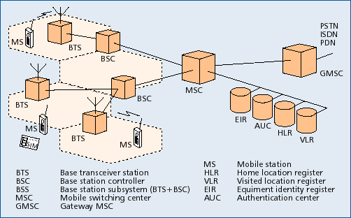
CELLULAR SYSTEM ARCHITECTURE
swj/21
Setiap cell dilayani oleh sebuah base station (BS)
Setiap BSS dihubungkan ke sebuah mobile switching center (MSC) melalui fixed links
Setiap MSC dihubungkan dengan MSC lain dan PSTN

Slide 42
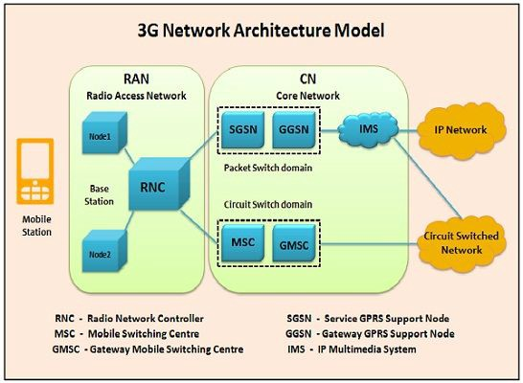

swj/21

Slide 43
3G CORE NETWORK
There are 4 main functions :
1. Circuit Switching: It uses Circuit Switched Network in which dedicated link or channel is provided for a particular time slot to set of users. The two functions which are related with circuit switching part is:
  MSC — Mobile Switching Centre manages circuit switched calls.
  GMSC — Gateway MSC acts as an intermediary between external and internal networks.
2. Packet-switching: It uses IP Network where IP’s are responsible for transmitting and receiving data among two or more devices. The two functions which are related with Packet Switching is:
  SGSN(Serving GPRS Support Node): The various functions provided by SGSN are mobility management, session management, billing, communication with other areas of the network.
  GGSN(Gateway GPRS Support Node): It can be considered as a very complex router and handles the internal operations between the external packet switched networks and UMTS packet switched network.
swj/21

Slide 44
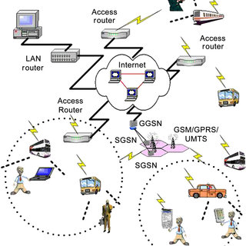
swj/21

Slide 45
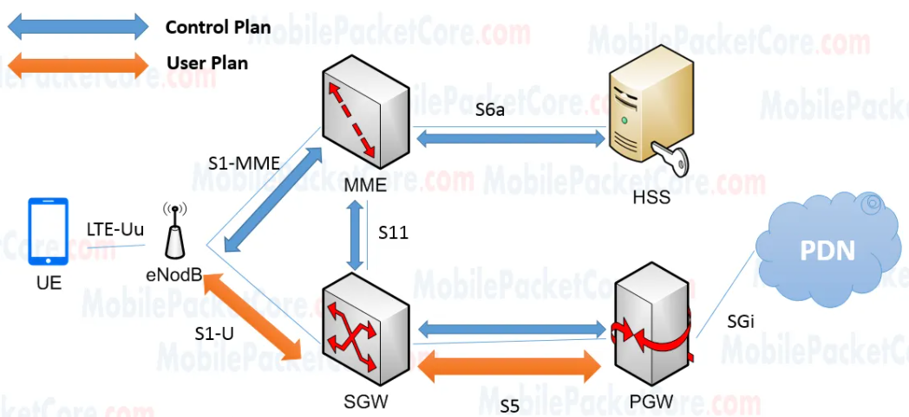
LTE (4G) NETWORK ARCHITECTURE
swj/21
MME: mobility management entity
SGW: serving gateway
PGW: PDN gateway
HSS: home subscriber server
PDN: public data network
https://mobilepacketcore.com/lte-4g-network-architecture/
Notes:
LTE = Long Term Evolution

Slide 46
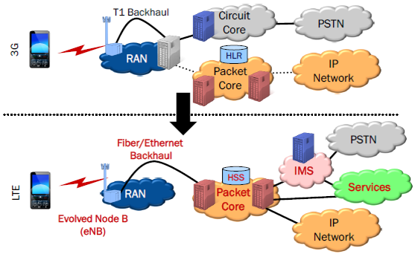
FROM 3G TO 4G
swj/21
IMS = IP Multimedia Subsystem
Mobile 3G/4G technologies are evolving for more data capacity → Shannon Channel Capacity

Slide 47
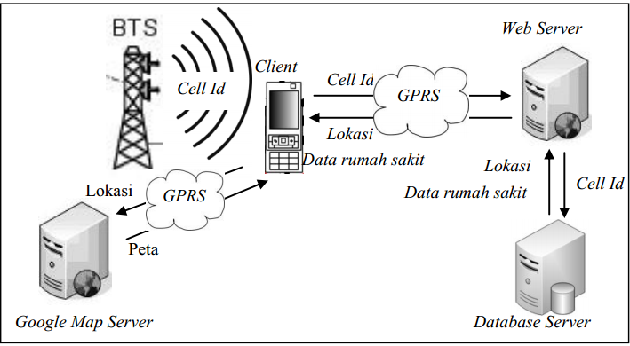
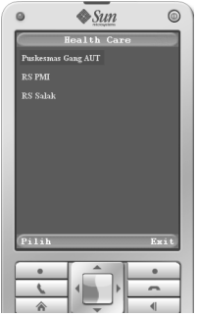
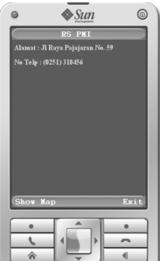
IMPLEMENTATION EXAMPLE
swj/21
Penentuan Lokasi Layanan Kesehatan Terdekat Berbasis Cellular Network Identification - Chairil Akbar (G64060278)

Slide 48
IDENTIFY CURRENT LOCATION OF THE CELLPHONE
four level of codes:
  MCC - Mobile country code (fixed code)
  MNC - Mobile network code (fixed code)
  LAC - Local Area Code (dynamic)
  CID - Cell ID (dynamic)
MCC/MNC: wikipedia.org: http://en.wikipedia.org/wiki/Mobile_Network_Code
LAC/CID:
  Cell finder: http://code.google.com/p/codetastrophe/ - Android
  Cell Tower Locator: http://www.appbrain.com/app/cell-tower-locator/tm.app.cellTowerLocator - Android
swj/21

Slide 49
REFERENSI
Leon, A. and Indra W. 2000. Communication Networks: Transmission Systems and the Telephone Network Ch 4. Int'l Ed. McGraw Hill Inc. Singapore. ISBN 0-07-022839-6.
swj/21

